Slide 1
Ship motion prediction with IMU-data and images
Lance De Waele
Supervisors:
Prof. dr. ir. Hiep Luong
Prof. dr. ir. Jan Aelterman
Counselors:
Charles Hamesse
Ir. Tien-Thanh Nguyen (Royal Military Academy)
Dr. ir. Benoit Pairet (Royal Military Academy)

Slide 2
Contents
Introduction
Goal & Incentive
Data
Deep learning
Proposed models
Results
Conclusion

Slide 3

Introduction
Royal Military Academy
Robotics & Autonomous Systems lab
MarLand
Developing an autonomous helicopter-type drone
Vertical Take-off and Landing (VTOL) on Belgian navy vessels
Notes:
The Robotics & Autonomous Systems lab is a research unit of the department of Mechanics of the Belgian Royal Military Academy.

Slide 4
Situation
Goal:
→ Safe and autonomous VTOL on Navy vessels
Problem:
→ Seaborne vessels are instable due to wave-induced motions
Proposed solution:
→ Predict motion of the vessel to anticipate movement
Notes:
Safety:
both drone itself and its surroundings
Minimize impact => Landing deck must be stabile and level
Problem:
Ship is moving due wind and currents but mainly due to ocean waves, causing uncontrollable instability of the landing deck
Solution:
Predict motion so we can avoid collision by anticipating future movements, not only of the landing platform, but also of the surroundings (antennas)
Other solutions
Dampen wave motions with (outside scope)

Slide 5
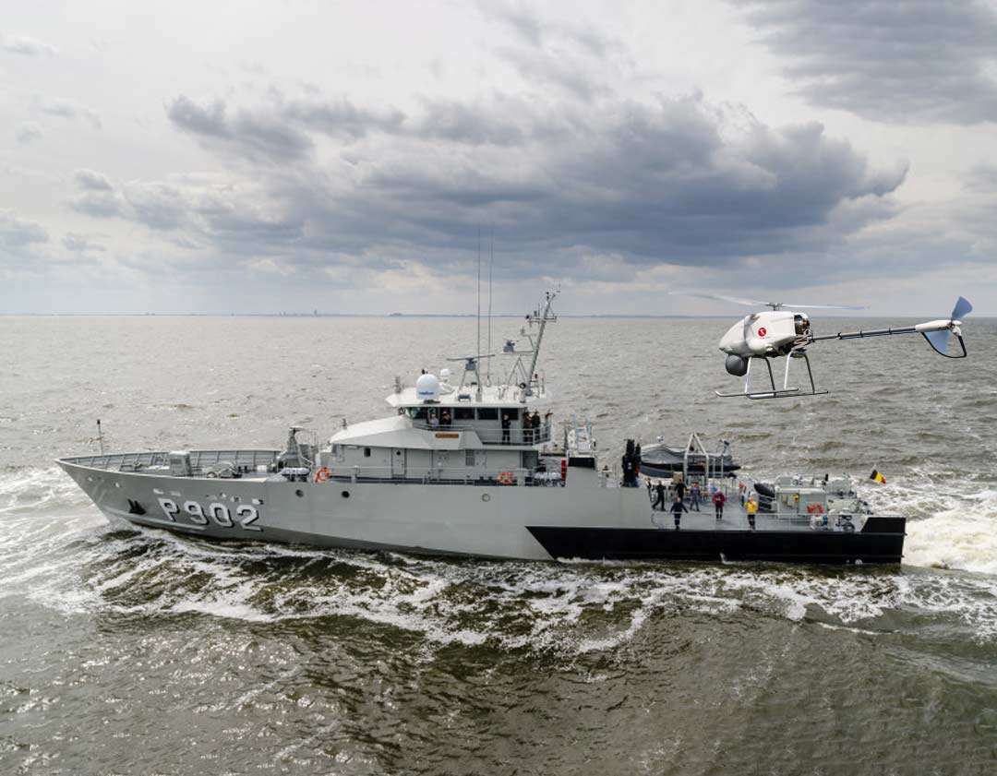
Situation
How ?
→ Deep neural networks
→ IMU data & wave images
Requirements:
Optimized for application
Minimum 30 seconds
Low latency & HW demand
Notes:
Train deep neural networks to map input of motions to a series of output motions
Predictions are facilitated by an onboard inertial measurement unit (IMU) and a front facing camera capturing incoming wave images
Optimized for drone VTOL and images and sensory data available
We want to be able to predict at least 30 seconds into the future to provide the drone with ample time to initiate a VTOL procedure: move in place, descend, ascend, move away
System needs to be lightweight to run on current hardware and not demand a lot of resources: both memory and compute, latency should be low to allow for quick corrections and continuous predictions

Slide 6
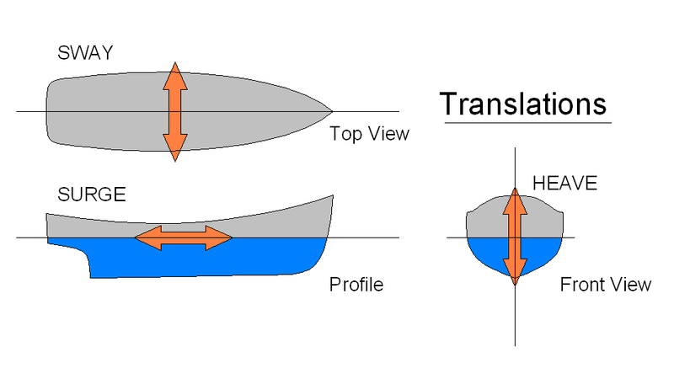
Ship Motion
Six Degrees of Freedom (DoF)
Translational
Sway
Surge
Heave
Notes:
The motion of any rigid object can be expressed in 6 degrees of freedom. These 6 DOF describe the 3D orientation of the object
They can be divided in two categories: translational and rotational.
Translational are expressed in distance units
Sway: lateral left and right movement - currents, wind, sidethruster
Surge: front and backwards movement - thrust of the vessel
Heave: up and downwards motion - wave induced motion

Slide 7
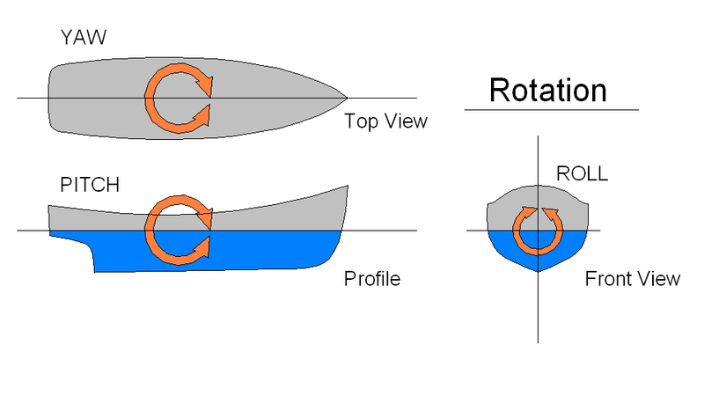
Ship Motion
Six Degrees of Freedom (DoF)
Translational
Sway
Surge
Heave
Rotational
Yaw
Pitch
Roll
Notes:
Rotational degrees of freedom are expressed in angular units
Yaw: steering of the vessel
Pitch: wave induced
Roll: wave induced

Slide 8
Ship Motion
Six Degrees of Freedom (DoF)
Translational
Sway
Surge
Heave
Rotational
Yaw
Pitch
Roll
Notes:
These 6 DoF describe the 3D orientation of the vessel and when measured over a sequence of time they describe the motion of the vessel. This motion can than be extended into the future by predictions
Three targets are selected:
Heave: impact
Pitch and roll: stability

Slide 9
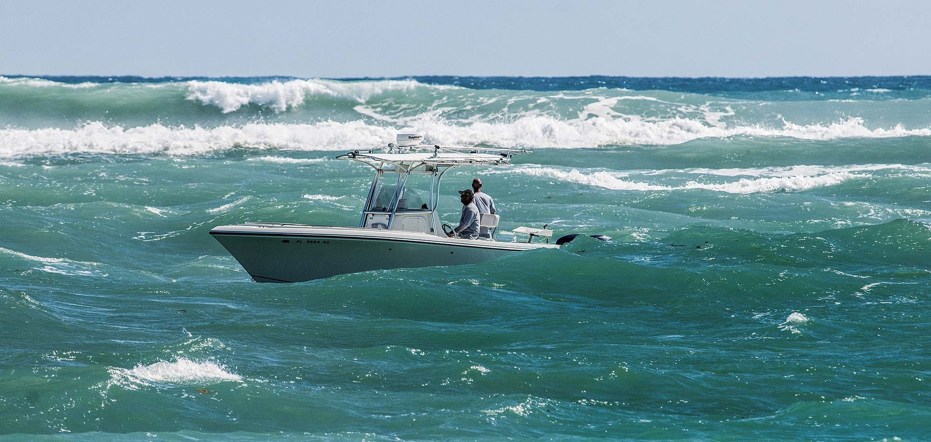
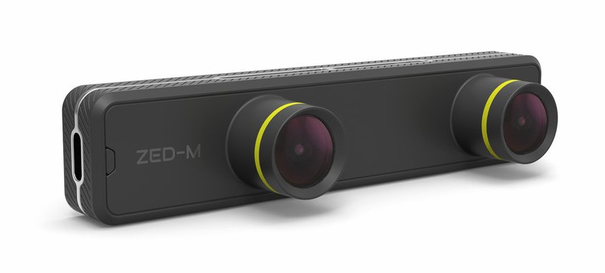
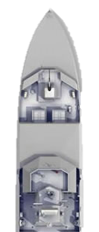
Sensor setup
ZED-mini:
Inertial Measurement Unit (IMU)
Translational
Rotational
Angular velocities
Stereo Camera
Incoming waves

Slide 10

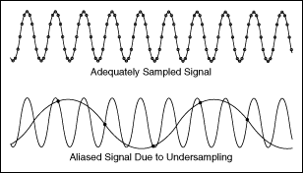
Simulated data
540 episodes of 400 frames each
Rendered at 2 frames/second (2Hz)
Overlap, processing demand
Aliasing ⥈ Accuracy
30 hours of simulation
Resolution 96x54
Pitch & Roll (PR) per image
No heave
₁Source: https://github.com/Nazotron1923/ship-ocean_simulation_BLENDER
Notes:
BLENDER SIMULATION
Justification for no heave:
Drone has large range of motion in heave but very small window in vertical hover pitch and roll
Lightweight drone with low inertia/high thrust can heave up/down based on measurements in real time

Slide 11
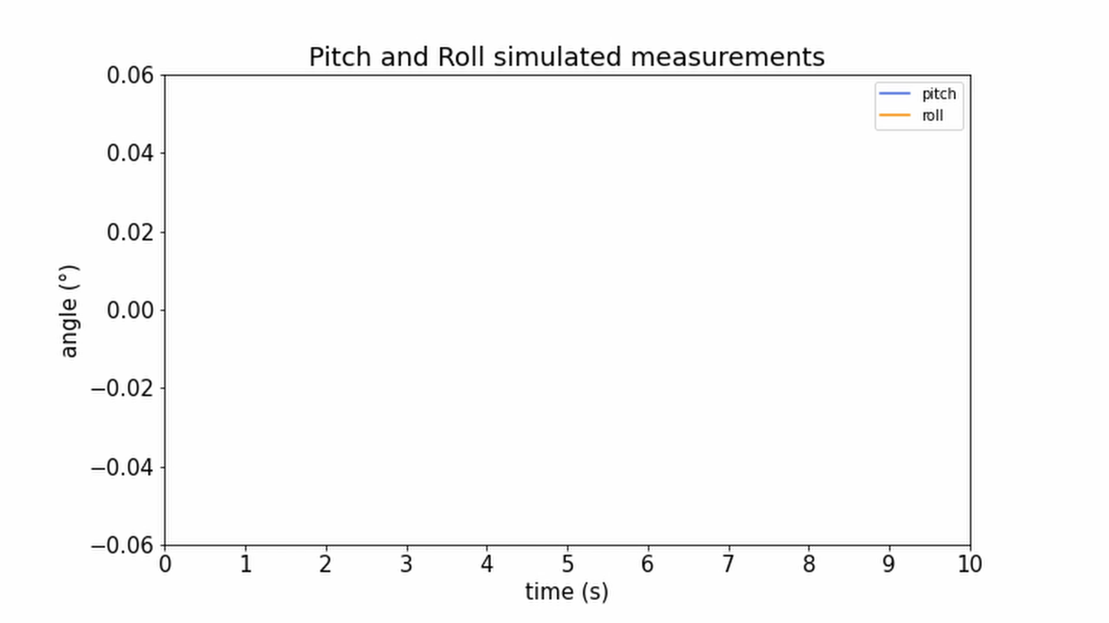
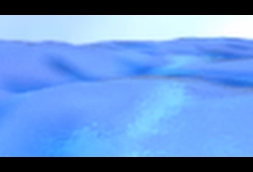
Simulated data
Notes:
Eén keer klikken once op deze slide

Slide 12
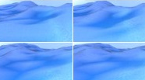
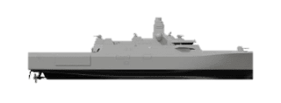
Simulation parameters
Daytime, clear weather
Sensor orientation
Height: 5m
Rotation: 76°
Varying ocean conditions
Sea depth
Wind velocity
Wave alignment
Choppiness
Notes:
Slightly tilted or pitch downwards
Sea depth influence the wave height

Slide 13
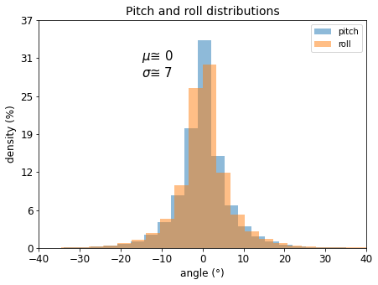
Properties
216.000 frames
540ep*400f
Symmetric around 0°
No skew
→ Normally distributed
99.7% : µ ± 3σ ≈ [-21°, 21°]
Notes:
Both pitch and roll are normally distributed, 99.7% in interval [-20°, 20°]

Slide 14
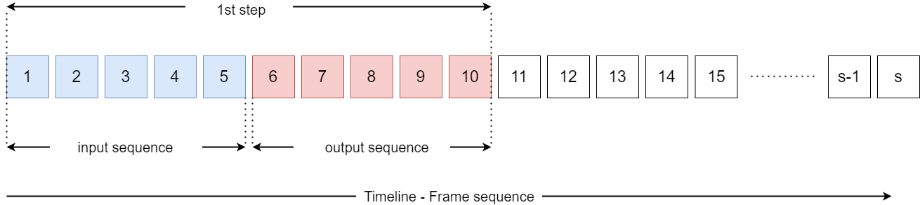
Pre-processing: sequencing
Notes:
s = 400 for simulated dataset en oneindig voor real-time data
Eerste 5 frames als input, een forward prediction voorspelt 5 nieuwe frames

Slide 15
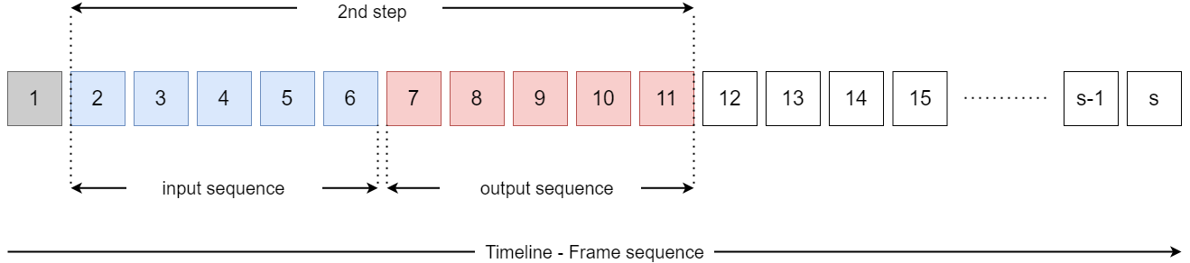
Pre-processing: sequencing
Optimal input-output (IO) ratio?
Notes:
Optimal IO-ratio?

Slide 16




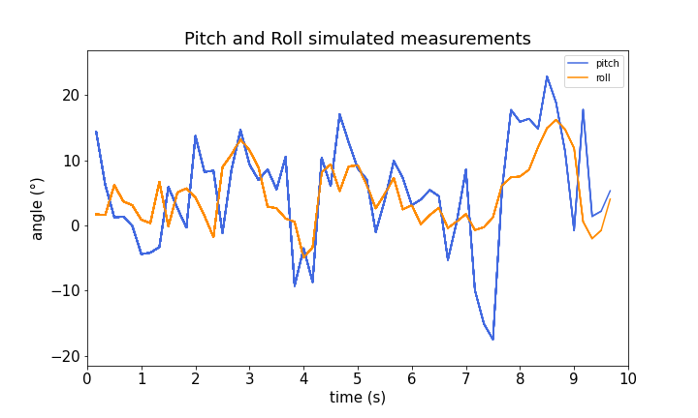
Deep neural networks
Modern and accessible
Facilitate …
Image processing
Continuous output
Time series data
→ Need for comprehensive ensemble of architectures

Slide 17
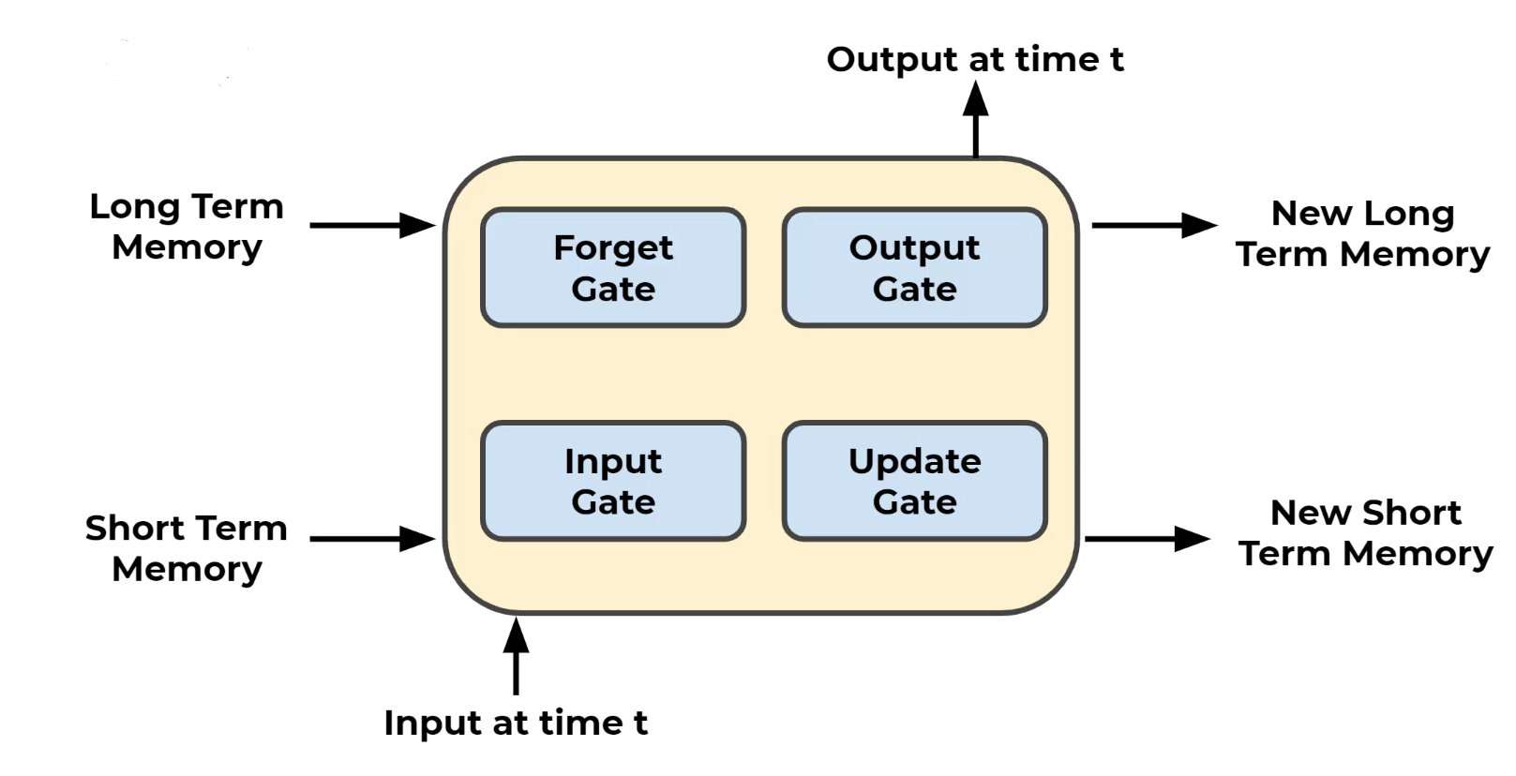
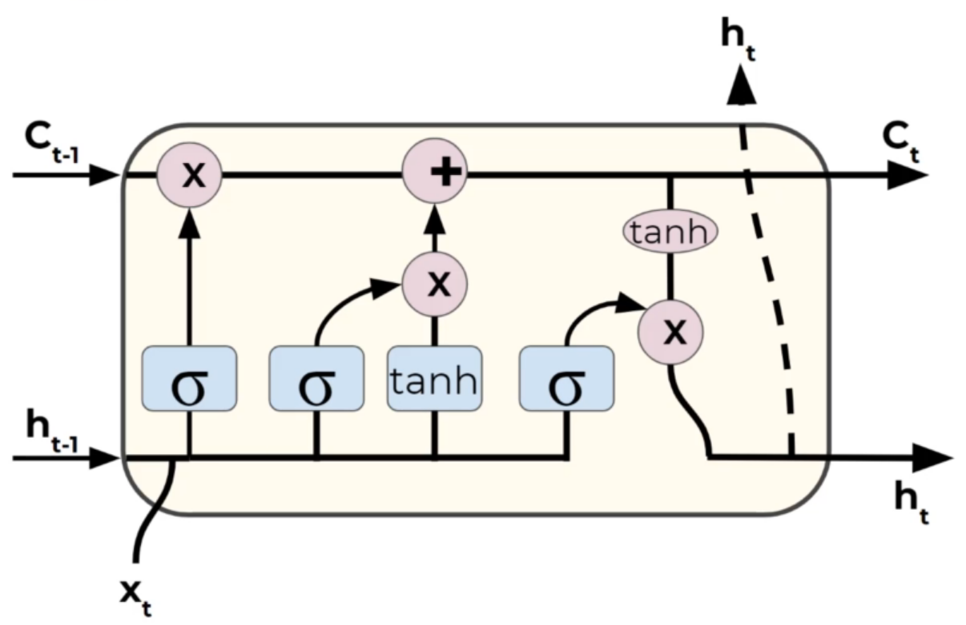
Neural network architectures: LSTM
Long-Short Term Memory network
Recurrent NN
Maintains two memory states
LSTM cell: 4 gates
Coupled sequentially

Slide 18
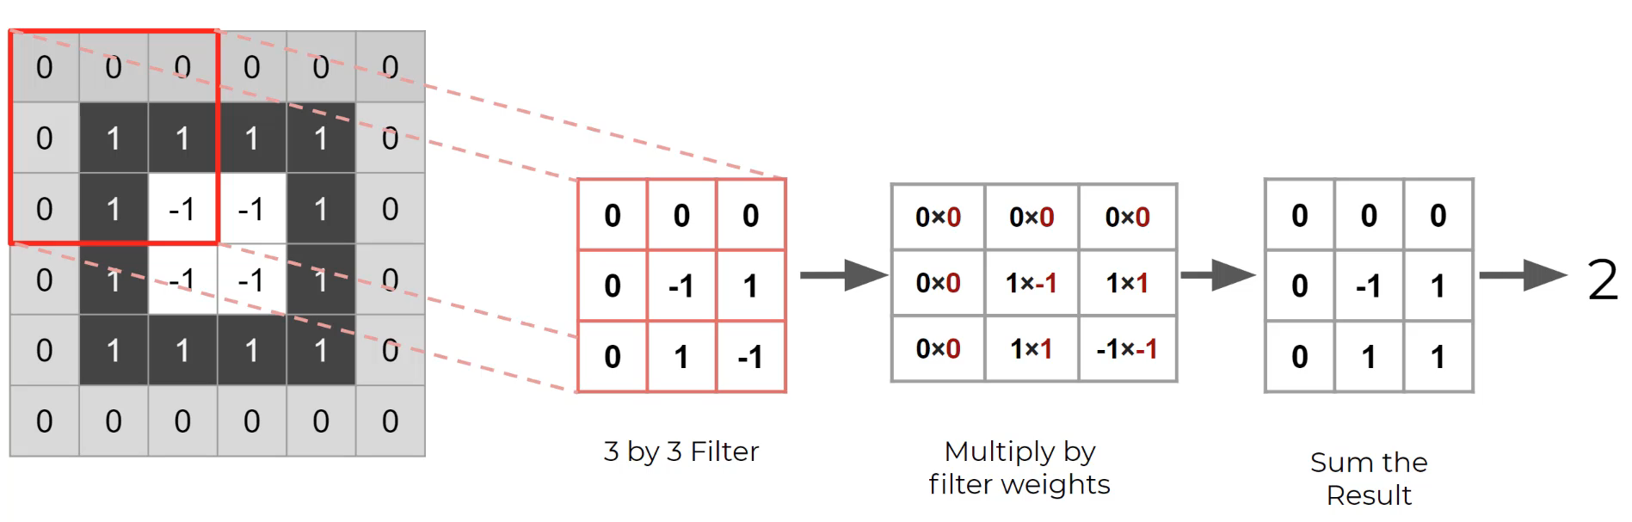
Neural network architectures: CNN
Convolutional Neural Network
Efficient for image processing
Convolving weighted kernels across image
Learns kernel weights for optimal feature extraction

Slide 19
Optimal architecture ?
Inputs: images and/or IMU ?
Architectures: CNN, LSTM ?
Hyperparameters: IO-ratio, hidden size ?

Slide 20
Proposed models

Slide 21
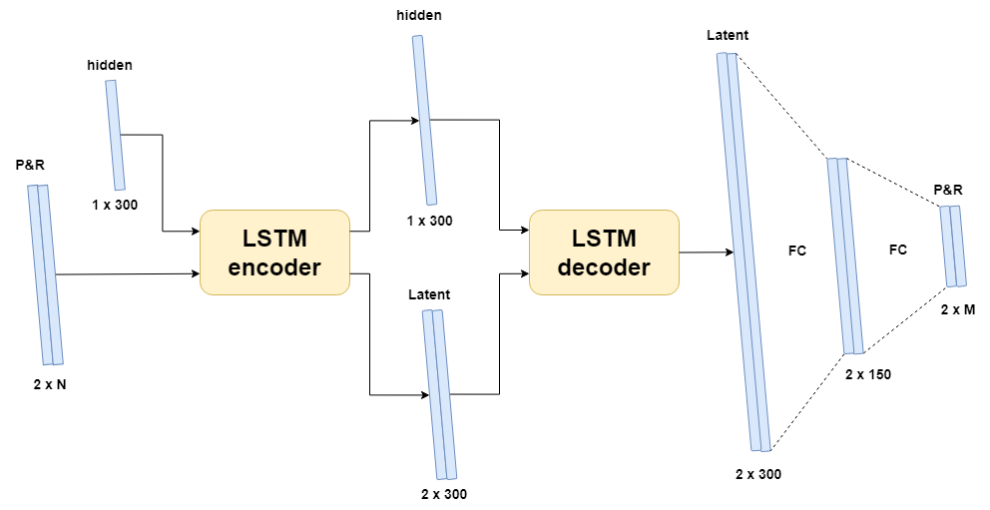
Encoder-Decoder LSTM
Layer | Input dim.
LSTM | 2 x N
LSTM | 2 x 300
Linear | 2 x 300
Linear | 2 x 150
Output | 2 x M
Notes:
No images

Slide 22
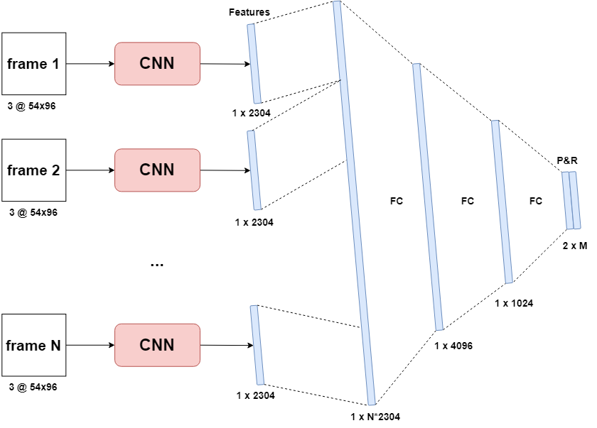
Sequential CNN
Layer | Input dim.
Conv2D | 3 x 54 x 96
ReLu | 8 x 54 x 96
MaxPooling | 8 x 54 x 96
Conv2D | 8 x 27 x 48
ReLu | 16 x 27 x 48
MaxPooling | 16 x 27 x 48
Conv2D | 16 x 13 x 24
ReLu | 32 x 13 x 24
MaxPooling | 32 x 13 x 24
Linear | 1 x N*2304
Linear | 1 x 4096
Linear | 1 x 1024
Tanh | 1 x 2*M
Output | 2 x M
Notes:
No PR

Slide 23
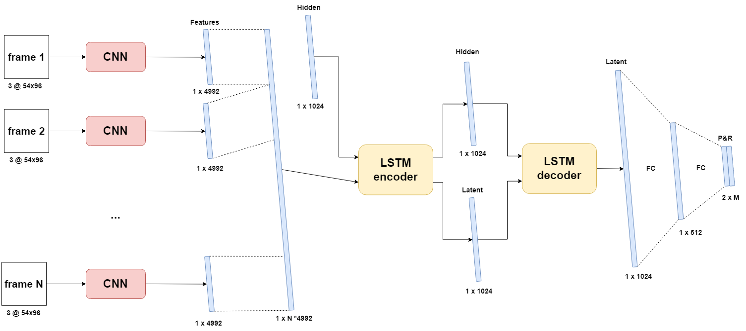
CNN-LSTM [img]
Layer | Input dim.
Conv2D | 3 x 54 x 96
ReLu | 8 x 54 x 96
MaxPooling | 8 x 54 x 96
Conv2D | 8 x 27 x 48
ReLu | 16 x 27 x 48
MaxPooling | 16 x 27 x 48
LSTM | 1 x N*4992
LSTM | 1 x 1024
Linear | 1 x 1024
Linear | 1 x 512
Tanh | 1 x 2*M
Output | 2 x M

Slide 24
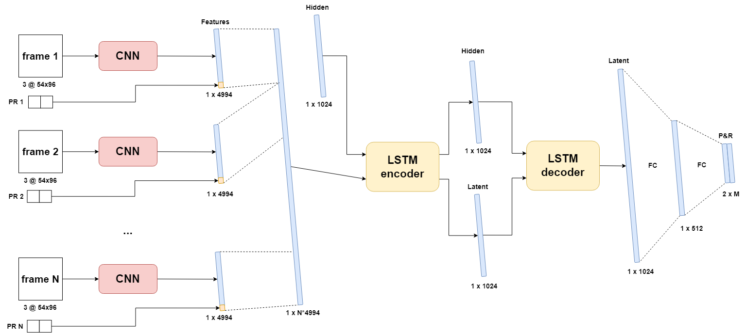
CNN LSTM [img+PR]
Layer | Input dim.
Conv2D | 3 x 54 x 96
ReLu | 8 x 54 x 96
MaxPooling | 8 x 54 x 96
Conv2D | 8 x 27 x 48
ReLu | 16 x 27 x 48
MaxPooling | 16 x 27 x 48
LSTM | 1 x N*4994
LSTM | 1 x 1024
Linear | 1 x 1024
Linear | 1 x 512
Tanh | 1 x 2*M
Output | 2 x M
Notes:
Also, img only

Slide 25
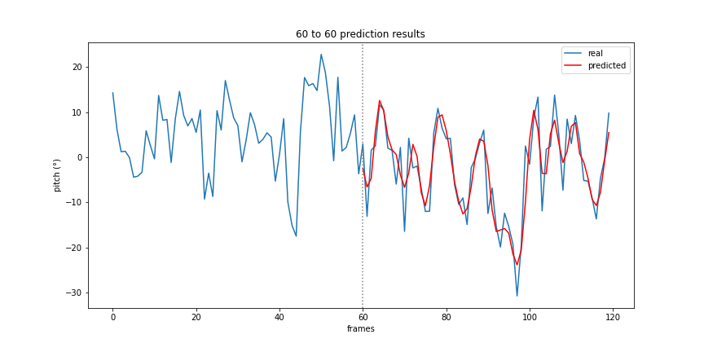
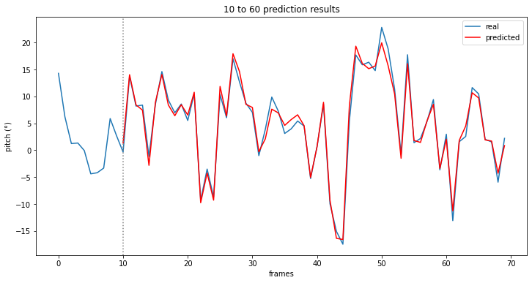
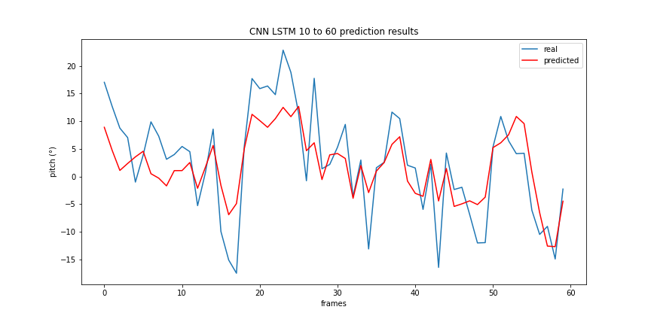
Prediction results
IO-ratios: 60/60 & 10/60
Real pitch (blue)
Predicted pitch (red)
Encoder-decoder LSTM – 60/60
Sequential CNN – 10/60
LSTM CNN [img+PR] – 10/60
Notes:
CONSISTENT Accuracy

Slide 26
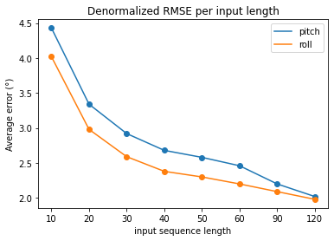
IO-ratio optimization
 | IO-ratio | Avg. Pitch error [denormalized RMSE] | Avg. Roll error [denormalized RMSE]
 | 10/60 | 4,43° | 4,02°
 | 20/60 | 3,34° | 2,98°
 | 30/60 | 2,92° | 2,59°
 | 40/60 | 2,68° | 2,38°
 | 50/60 | 2,58° | 2,3°
 | 60/60 | 2,46° | 2,2°
 | 90/60 | 2,2° | 2,09°
 | 120/60 | 2,02° | 1,98°
 | zero-prediction | 6,43° | 7,30°

Slide 27
Optimized results
Model name | IO-ratio | Inference time | Avg. PR error | Trainable parameters
Encoder-Decoder LSTM | 120/60 | 155ms | 2° | 1 211 010
Sequential CNN | 10/30 | 4 203ms | 5.79° | 98 639 180
CNN LSTM [img] | 10/120 | 4 042ms | 1.73° | 217 659 752
CNN LSTM [img] (gray) | 10/120 | 3 545ms | 1.71° | 217 659 352
CNN LSTM [img-PR] | 10/120 | 4 453ms | 1.72° | 217 741 672
CNN LSTM [img-PR] (gray) | 10/120 | 3 797ms | 1.81° | 217 741 272

Slide 28
Optimized results
Model name | IO-ratio | Inference time | Avg. PR error | Trainable parameters
Encoder-Decoder LSTM | 120/60 | 155ms | 2° | 1 211 010
Sequential CNN | 10/30 | 4 203ms | 5.79° | 98 639 180
CNN LSTM [img] | 10/120 | 4 042ms | 1.73° | 217 659 752
CNN LSTM [img] (gray) | 10/120 | 3 545ms | 1.71° | 217 659 352
CNN LSTM [img-PR] | 10/120 | 4 453ms | 1.72° | 217 741 672
CNN LSTM [img-PR] (gray) | 10/120 | 3 797ms | 1.81° | 217 741 272
Notes:
Up to 120 second prediction, low 10% relative error, good inference time

Slide 29
Optimized results
Model name | IO-ratio | Inference time | Avg. PR error | Trainable parameters
Encoder-Decoder LSTM | 120/60 | 155ms | 2° | 1 211 010
Sequential CNN | 10/30 | 4 203ms | 5.79° | 98 639 180
CNN LSTM [img] | 10/120 | 4 042ms | 1.73° | 217 659 752
CNN LSTM [img] (gray) | 10/120 | 3 545ms | 1.71° | 217 659 352
CNN LSTM [img-PR] | 10/120 | 4 453ms | 1.72° | 217 741 672
CNN LSTM [img-PR] (gray) | 10/120 | 3 797ms | 1.81° | 217 741 272
Notes:
Suffers from not having LSTM, high inference time, low IO still high error

Slide 30
Optimized results
Model name | IO-ratio | Inference time | Avg. PR error | Trainable parameters
Encoder-Decoder LSTM | 120/60 | 155ms | 2° | 1 211 010
Sequential CNN | 10/30 | 4 203ms | 5.79° | 98 639 180
CNN LSTM [img] | 10/120 | 4 042ms | 1.73° | 217 659 752
CNN LSTM [img] (gray) | 10/120 | 3 545ms | 1.71° | 217 659 352
CNN LSTM [img-PR] | 10/120 | 4 453ms | 1.72° | 217 741 672
CNN LSTM [img-PR] (gray) | 10/120 | 3 797ms | 1.81° | 217 741 272
Notes:
Gray, little improvement in accuracy, high latency for all, much better with lstm

Slide 31
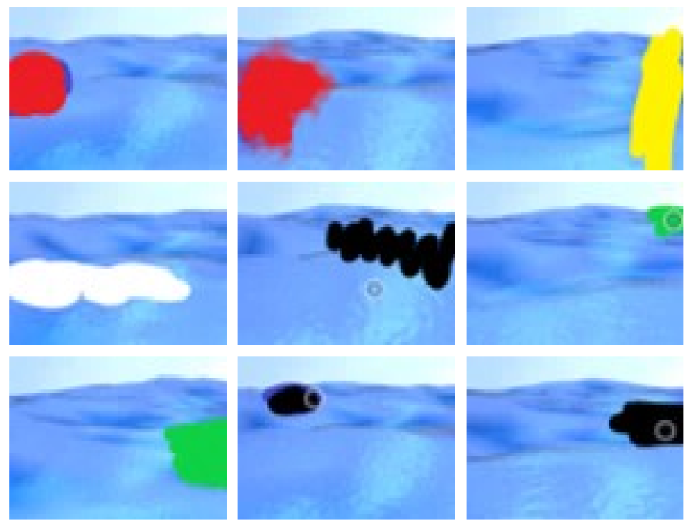
Augmented data tests
400 frames of augmented data: manual ink blots
Simulate obstruction/occlusion
Worst case scenario
CNN LSTM trained on normal data
→ Tested on augmented data

Slide 32
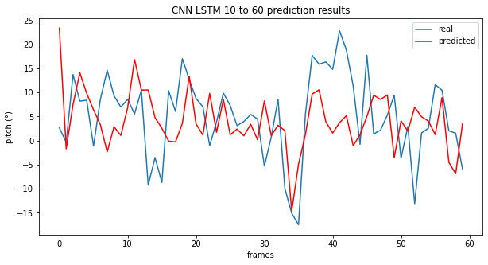
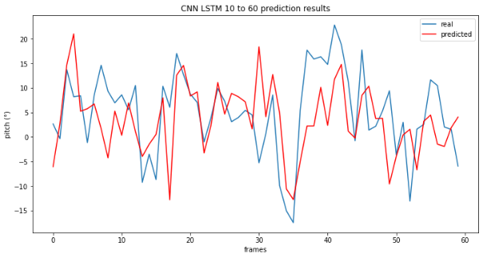
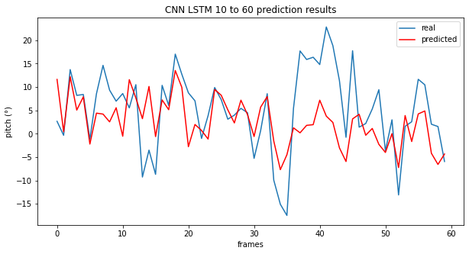
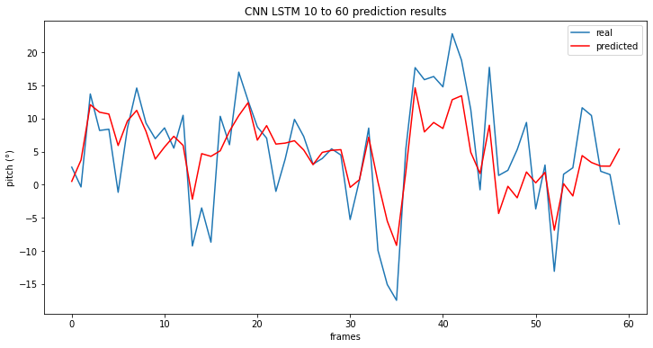
CNN LSTM [img] prediction on augmented frames: grayscale (left) and colored (right)
CNN LSTM [img+PR] prediction on augmented frames: grayscale (left) and colored (right)
Notes:
Pitch only

Slide 33
Conclusion
Images contribute to …
Marginal increase in accuracy
Significant increase in latency & memory
Prone to occlusion/obstructions
LSTM module is crucial
Encoder-Decoder LSTM is the optimal model
Up to 120 seconds
2° error on average
Consistent & equal accuracy

Slide 34
Future work

Slide 35
Real data
Live video + IMU data (ZED-mini)
Additional inputs
Angular velocity
Wind speed/direction
Thrust
Challenges:
Optimal sample rate
Objects in images
Stabilization
Noise

Slide 36
Questions

